Slide 1
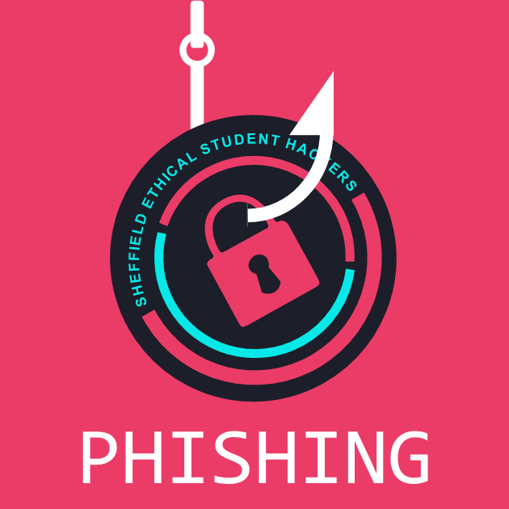
Ethical Student Hackers
Social Engineering

Slide 2
The Legal Bit
The skills taught in these sessions allow identification and exploitation of security vulnerabilities in systems. We strive to give you a place to practice legally, and can point you to other places to practice. These skills should not be used on systems where you do not have explicit permission from the owner of the system. It is VERY easy to end up in breach of relevant laws, and we can accept no responsibility for anything you do with the skills learnt here.
If we have reason to believe that you are utilising these skills against systems where you are not authorised you will be banned from our events, and if necessary the relevant authorities will be alerted.
Remember, if you have any doubts as to if something is legal or authorised, just don't do it until you are able to confirm you are allowed to.

Slide 3
Code of Conduct
Before proceeding past this point you must read and agree to our Code of Conduct - this is a requirement from the University for us to operate as a society.
If you have any doubts or need anything clarified, please ask a member of the committee.
Breaching the Code of Conduct = immediate ejection and further consequences.
Code of Conduct can be found at https://shefesh.com/downloads/SESH%20Code%20of%20Conduct.pdf

Slide 4
Social Engineering - What is it?
Social engineering is the psychological manipulation of people into performing actions or divulging confidential information
Vishing, phishing, smishing, impersonation, pretexting, spear phishing, water holing, baiting, quid pro quo, tailgating, scareware, credential harvesting...

Slide 5
Phishing
Cyber attack that targets victims via email that lures the victims into providing sensitive data or completing an action
Credential harvesting
Downloading malware
Identity fraud
Financial fraud
The list goes on and on…

Slide 6
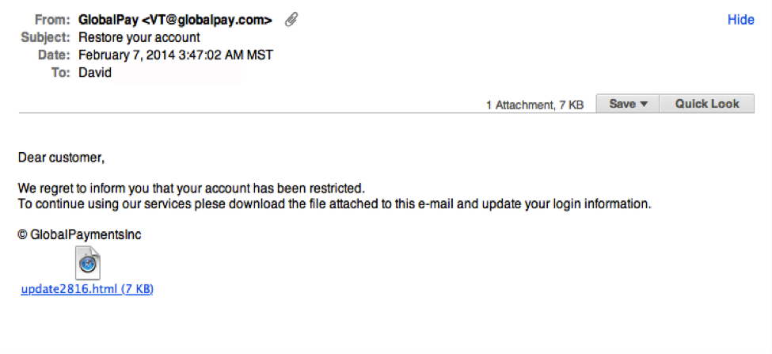
Phishing examples

Slide 7
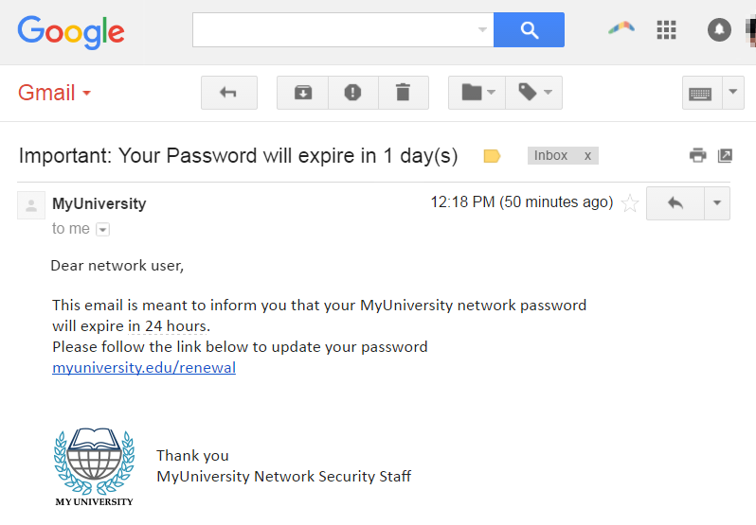
Phishing examples

Slide 8
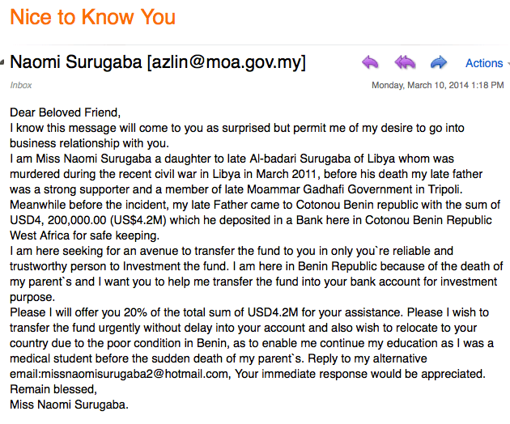
Phishing examples

Slide 9
Creating a phishing campaign
Legalities of phishing
Phishing that is not for educational and training purposes breaches The Fraud Act 2006 and is ILLEGAL! Offences under these Acts are punishable by fines and / or imprisonment up to 10 years

Slide 10
Creating a phishing campaign
GoPhish
Gophish is an open-source phishing toolkit designed for businesses and penetration testers. It provides the ability to quickly and easily setup and execute phishing engagements and security awareness training
https://github.com/gophish/gophish

Slide 11
Creating a phishing campaign
Optimising your campaign
You want to trick your users into thinking the email is genuine
Look professional
Accurate spelling and grammar
Pass SPAM filters
Get something out of it (in this case, credit card info)
Email headers
Find a SPAM score for our email - https://www.mail-tester.com/

Slide 12
Protecting against a phishing campaign
Anti-spam filters
Training of staff/yourself
Protect yourself from malicious links if you do click them using a proxy
The best form of protection is being aware and being careful!

Slide 13
Anti-spam filters
A program that is used to detect unsolicited and unwanted email and prevent those messages from getting to a user's inbox
SpamAssassin
Apache SpamAssassin is the #1 Open Source anti-spam platform giving system administrators a filter to classify email and block "spam" (unsolicited bulk email). It uses a robust scoring framework and plug-ins t integrate a wide range of advanced heuristic and statistical analysis tests on email headers and body text including text analysis, Bayesian filtering, DNS blocklists, and collaborative filtering databases.

Slide 14
SpamAssassin - I run a mail server
Using with Procmail
Procmail - A mail delivery agent that processes all messages before they reach your mailbox
Put some the following into the .procmailrc file...
(Instructions for other setups are available here https://cwiki.apache.org/confluence/display/SPAMASSASSIN/StartUsing)

Slide 15
SpamAssassin - I run a mail server
:0fw: spamassassin.lock
* < 512000
| spamassassin
:0:
* ^X-Spam-Level: \*\*\*\*\*\*\*\*\*\*\*\*\*\*\*
almost-certainly-spam
# The lock file ensures that only 1 spamassassin invocation happens at 1 time, to keep the load down
# Score of 15+ is almost certainly spam. Move to different mailbox

Slide 16
SpamAssassin - I run a mail server
:0:
* ^X-Spam-Status: Yes
probably-spam
# Mail that is tagged as spam based on set threshold is moved to a different mailbox
These are only some basics and there are so many more setup options available!

Slide 17
Social Engineering Tools
https://github.com/trustedsec/social-engineer-toolkit
The Social-Engineer Toolkit is an open-source penetration testing framework designed for social engineering. SET has a number of custom attack vectors that allow you to make a believable attack quickly.
Many of the techniques learnt today can also be applied to other packages such as the SEToolKit

Slide 18
Upcoming Sessions
22d Feb - Introduction to Assembly
1st Mar - Game Breaking
8th Mar - Making a CTF
15th Mar - Web App Hacking
22nd Mar - HTB Walkthrough
What’s up next?
www.shefesh.com/sessions

Slide 19

Any Questions?
www.shefesh.com
Thanks for coming!

